Slide 1



Hysteria Without Rebellion
The Causes and Effects of Hysteria Around
Slave Insurrections in Confederate Mississippi
Hayden Wright
Mississippi State University
Notes:
Hello my name is Hayden Wright, I go to MSU, and over the past 8-weeks I have done research concerning the causes and effects from the fear of slave insurrections during the civil war.

Slide 2

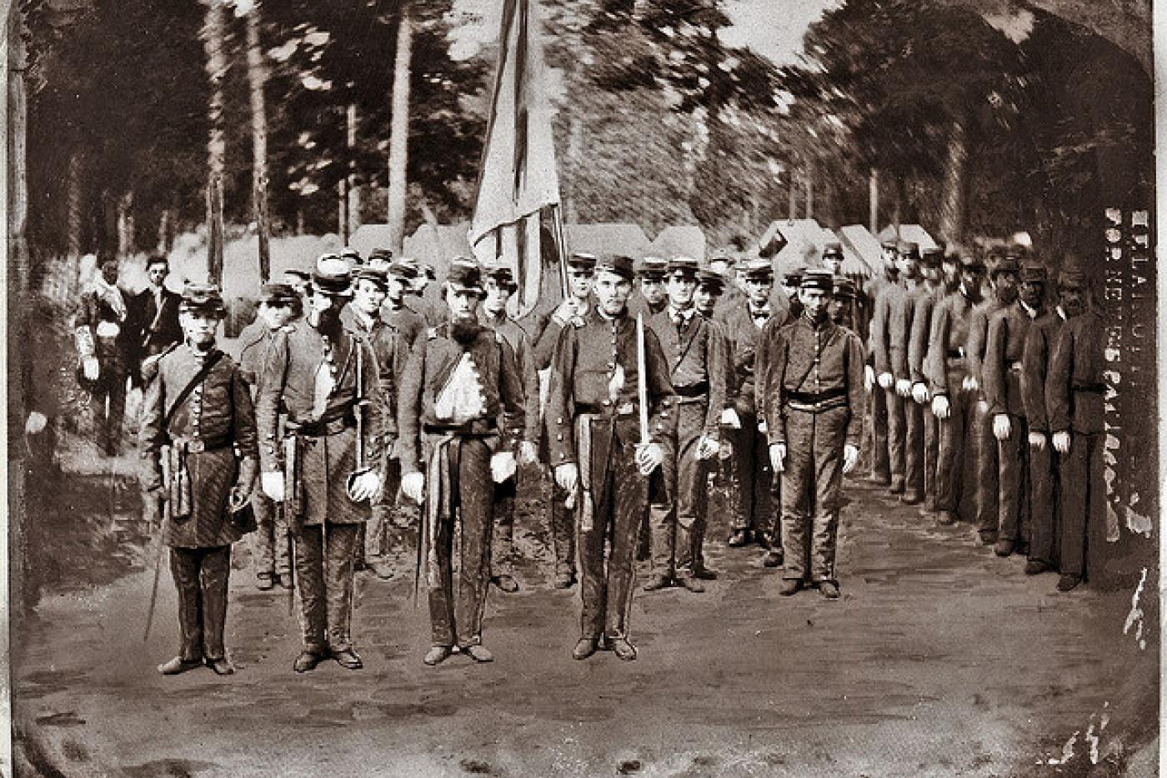
Slave revolution events paired with the Union’s goal of liberating slaves led white southerners to fear that their slaves would revolt.
Many southern men were conscripted into war, leaving plantations under less supervision.
Fears that slaves would revolt led to the creation of militias that operated outside the Confederate military to maintain control and suppress possible uprisings.
Hdnet Nwd J jwndjn wlkdn QKSKmwk Wnskn WKkwnkk
sdnwsnNWKNDk mkWKmd KWMDkmwd
WND nwkC kcnw
Weeknd Wmd
Mmk Wmd
Ndkw Nd
Wliw
wdwddffefref2efi2no
Intro - Hysteria
North Carolina State Archives, Raleigh, NC.
Notes:
When the civil war broke out in the mid-1800’s, the primary conflict between the north and the south was the debate on whether or not the south should keep their slaves.
Due to the union’s goal of emancipating slaves and events in the past such as the Haitian Revolution and the Harper’s ferry raid, paired with conscription causing men to leave their plantation posts, the idea of slave rebellions began causing hysteria across slave owners from the time, many going as far as to write the governor before the war had even started concerning their fears. In response to this, local civilian militias often referred to as the “Home Guard” would be created outside of but often work with the confederate military to maintain control against the people they oppressed. Often by accusing and imprisoning slaves they thought were a threat to the plantation.

Slide 3

How did slave rebellions and the fear around them affect the homefront of Confederate Mississippi?
How did hysteria around slave rebellions affect the Mississippians during the Civil War?
Notes:
I went into this research mainly wondering how did rebellions and the fear that of affect the homefront in confederate mississippi, but also how did the hysteria around said rebellions affect mississippians.
And what I found through my research was that the rhetoric concerning the fear of slave violence was prominent and did affect, mostly negatively overall, how the confederacy handled their troops and aid during the time.

Slide 4
Methodology
Letters from the CWRGM with the tag :
“Military Procedures & Events--Insurrections”
were collected, and then sorted based on topic.
Letters with locational data were then mapped using QGIS over a map showcasing the enslaved population by county.
Letters were then reread and analyzed with additional context in order to derive additional meaning.
Notes:
My research started by looking at letters tagged “Military Procedures & Events--Insurrections” as it was the most common to discuss slave insurrections, then from there I cut out all the letters post emancipation. Then I sorted the letters by topic based on the patterns often discussed in the letters, and then mapped the ones that correlated to the topic that had locational data.

Slide 5
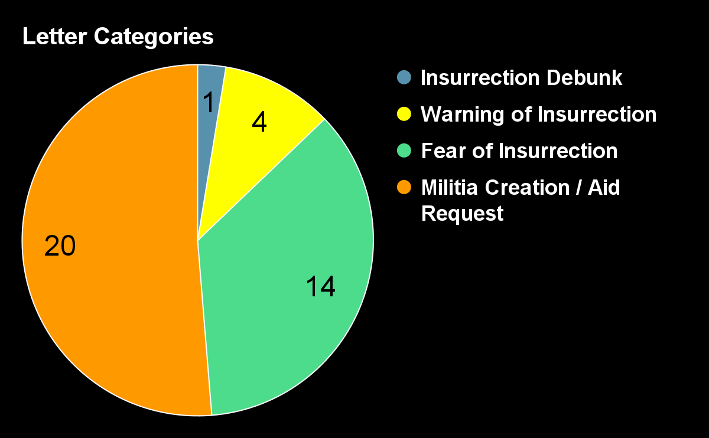
The Governor did not receive any letters concerning an actual insurrection.
Notes:
So consulting the chart, the primary reasons people mailed the governor was usually to tell him that that either were developing a “Home Guard” or to express they felt things like conscription would lead to their slaves' insurrection. Interestingly not a single letter tagged “Military Procedures & Events--Insurrections” concerns a writer alerting the Governor of an actual slave insurrection.

Slide 6
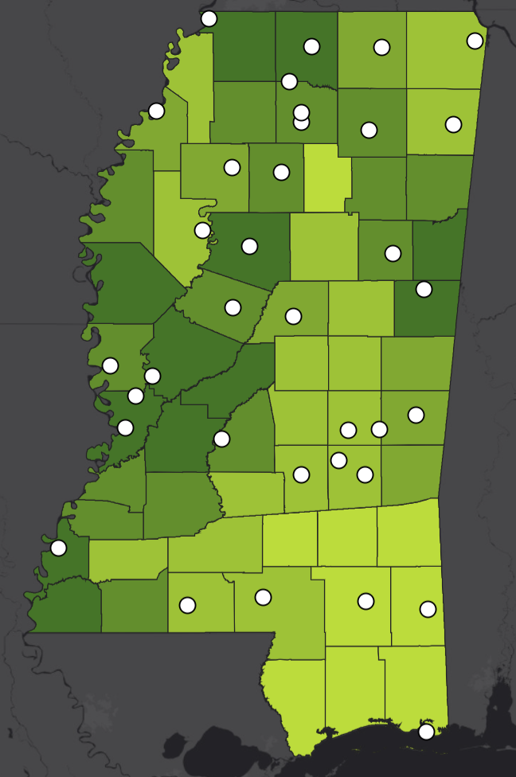
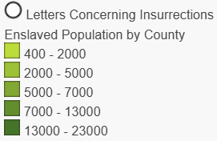
Notes:
While most of these letters seem to be normal, because we have gained additional insight through mapping the data of where these letters come from, you can see while letters are largely coming from areas with a higher volume of slaves, letters asking for aid or expressing fear are still pretty scattered.

Slide 7
Results
Enslaved Population | Letters In Each County
400 - 2000 | 3
2000 - 5000 | 10
5000 - 7000 | 5
7000 - 13000 | 9
13000 - 23000 | 8
Letters concerning insurrections, aid requests, and fear of them were present all across Mississippi.
Hysteria was still fairly widespread, and letters were sent from counties with smaller slave populations.
Notes:
So from here, the question became why? Why despite these counties having such low enslaved numbers were letters requesting aid and touting fear still so prominent.

Slide 8
The Rhetoric of Insurrection and Fear:
The Politics of Slave Management in
Confederate Georgia
Uses the letters sent to the governor of Georgia during the Civil War as a primary source.
Makes notes and connections about hysteria toward slave insurrections through the context provided by the letters.
Serves as a mirror to my own research, but only goes over Georgia.
Notes:
During my research I discovered an article by David T. Gleeson. Now Gleeson followed a very similar study to my own, he instead however collected letters from the governor of Georgia, and made connections to hysteria from the context provided there.

Slide 9
The Rhetoric of Insurrection and Fear:
The Politics of Slave Management in
Confederate Georgia
Found that in Georgia people did have initial fears regarding the possibility of a slave insurrection.
As the years went on people used the rhetoric of slave violence to further their own personal gain through receiving additional aid.
Found that people use prospects of “protecting their families and land” as excuses for avoiding conscription.
Notes:
What he found is that while there were initial concerns about slave insurrections, as the war continued people often used the rhetoric of slave violence to further their personal agendas and gain government aid for free during wartime. These people would often use claims about protecting their families from violence as excuses to avoid conscription even though they would face no serious threat.

Slide 10

Dated December 1860, months before Mississippi joined the confederate states.
A commander of a volunteer army hears word of a “Harpers Ferry” akin raid happening in a county with a high enslaved population.
Primarily asks for advice and takes personal measures to “ensure the public’s peace and safety”.
Hdnet Nwd J jwndjn wlkdn QKSKmwk Wnskn WKkwnkk
sdnwsnNWKNDk mkWKmd KWMDkmwd
WND nwkC kcnw
Weeknd Wmd
Mmk Wmd
Ndkw Nd
Wliw
wdwddffefref2efi2no
“To you, We have reason to apprehend a raid similar to that at Harpers Ferry, in the adjoining County of Issaquena—I shall take the most effectual Means in my power to Nip the affair in the bud”
“if it is not within my power to order the volunteer troops of this city to any portion of my division that may be menanced.”
“I have already taken meas-ures for an ample supply of ammunition, as well for artillery as for Infantry and rifles, and spare no means in my power to ensure the public peace and safety.”
https://cwrgm.org/item/mdah_757-930-12-15
Notes:
This letter comes from a general who was overseeing a group of volunteer soldiers before Mississippi even joined the confederacy. He worries of a rumor that a Harpy Ferry like raid will occur and asks for help from the governor on how to respond. Comparing it to another event is a perfect example of how outside influence has caused hysteria and rumors to spread, and in response the commander only asks for the best course of action to protect the public from a potential uprising. I view this letter as a piece of actual hysteria influencing decisions made at the time by the public

Slide 11

Intro
Intro
Sent during the Civil War in 1861
Opens with stating he and others are creating a “Home Guard” for the purpose of personal protection.
Makes baseless rumors of oncoming insurrections.
Only asks for new guns to replace their old guns.
“The old and inefficient men of Oak Bowery neighborhood have organised a Company of "Home Guards," for the purpose of protecting their homes and familys”
“Rumours are rife, that the negroes of the surrou=nding neighborhoods are making preparations to raise an insurrection, "headed by white men," as soon as our volunteers leave.”
“The arms that we have are very inferior and inefficient. "Therefore I wish to learn of your excellency," if I can obtain a Sufficient number of "Muskets," to arm and equip my Company.”
https://cwrgm.org/item/mdah_757-932-01-22
Notes:
In contrast to the previous letter, this one opens detailing to the governor how people in the area have formed a “Home Guard” and intend to help the war effort by defending plantations. In addition to discussing rumors of a slave insurrection he then follows it up by asking if the Governor could send muskets to their plantations only for the purpose of replacing their old ones. This letter shows not only using the rhetoric of slave violence to manipulate the governor into sending aid, but also shows how the people of Mississippi were okay using military materials for personal use and profit.

Slide 12

Letter comes from Deer Creek, which was known for being a long stretch of back-to-back large plantations.
Writes concerning conscription, and worries if men continue to be drafted the white population will soon be surpassed by the enslaved population.
Requests no aid, just to be ignored from Conscription
Claims that slaves have already began fleeing their land, not taking up arms.
Hdnet Nwd J jwndjn wlkdn QKSKmwk Wnskn WKkwnkk
sdnwsnNWKNDk mkWKmd KWMDkmwd
WND nwkC kcnw
Weeknd Wmd
Mmk Wmd
Ndkw Nd
Wliw
wdwddffefref2efi2no
“I allude to the effect of the conscription, if fully carried out, here. The county is now nearly drained of its white male population, with, as you are aware, a very large population of slaves.
Here on Deer Creek, there is a continuous string of large plantations, the whole length of the county, and not enough white men on them to perform efficient patrol duty.
…Starvation will be in our midst.
I learn that some 20 negroes have already left the Hill places in the lower end of this county, for the Yankees.”
https://cwrgm.org/item/mdah_757-942-01-17
Notes:
On the topic of conscription, this letter highlights how in areas like Deer Creek, known for its high volume of plantations and heavy slave population, were worried about the number of people being conscripted eventually leading to the enslaved population outweighing the white population. While this letter does discuss the possibility of a violent insurrection, it however only talks about how slaves fled the counties which is much more realistic when it comes to how slaves would free themselves. While no actual insurrections occurred as a result of conscription, I believe the fears felt by people from conscription were genuine and this letter is an excellent showcase of that fact.

Slide 13
Intro
Intro
The author was a slave handler who in another letter, owned $18,000 in property.
Makes claims of men being unfit to fight in the war despite them in active patrol duty on plantations.
Letter has a demanding and somewhat manipulative tone when it comes to discussing whether or not men should be conscripted from the county.
“A large portion of the 149 men, say about 40, now have certificates of physicians of their inability, and many of them who are drafted as Minute Men have not applied for certificates through pride, but will no doubt get them if they should be ordered off.”
“This county is principally a planting community & nearly every man that could be spared at all is already in the field.”
“in my judgement there ought not to be takin a single man from this county by force and all who ought or can leave at all will do so.”
https://cwrgm.org/item/mdah_757-942-03-08
Notes:
This doesn’t mean however that white southerners didn’t use the rhetoric of conscription causing an enslaved pop to oversee imbalance as an excuse as well. In this letter, the author is a slave owner who during the time owned $18000 dollars in property. He starts by making claims that none of the men who are actively working for him in his home guard are able to fight in the war despite actively running his plantations. He follows it up in a somewhat demanding and manipulative way by saying it would be his best judgement to not conscript more from the county and that all the men who would fight would have already done so. Again we see people protecting themselves and in some ways are holding back the confederate war effort.

Slide 14

Provides context to the fact that if the hysteria people were feeling were genuine or not, the ever oncoming letters requesting aid was ultimately wasting the time and resources of the Confederate army.
The rhetoric of violence and the fear of Mississippians was still ultimately costing the Confederacy in the war overall.
Dear Sir
Please give me the name of the person that sent you a dispatch that there was an insurrection in Panola Co Miss
Every word of it is false, The Troops sent down have returned
Respecty[sic]
Yours
F. M White Pres, M—
https://cwrgm.org/item/mdah_757-932-01-13
Notes:
The last letter I would like to look at today I think drives home the effect the hysteria was having on the confederate army in a brief letter. It comes from a Commander who during the civil war sent troops to investigate an alleged insurrection. It says simply that the troops have returned and every word was false.

Slide 15
Conclusion
Civilians struggled in maintaining their way of life due to fear of the people they oppressed fighting back.
The Mississippi Confederate army struggled due to the hysteria as military aid was wasted and men dodged conscription to oversee slaves.
Notes:
Hysteria concerning slave insurrections clearly had a grip on the Mississippians at the time, as they struggled to maintain their way of life in a bloody war all in the means of oppression. Their slaves revolting clearly brought them unease as more men were conscripted. And while no serious revolts seemed to have occurred in Mississippi it is undeniable that the hysteria, both real and fake, ended up costing the confederacy men and aid that could have been used in the war all in an effort to suppress and enforce the slaves they were fighting to keep.

Slide 16
For Future Research
This research could be continued by analyzing other states using similar methods to see if the same patterns appear.
For research to continue being done in Mississippi, it would be good to stem outward from just letters sent to the Governor of Mississippi for data collection.
Notes:
For future research into this topic, it would be good to continue looking into more states in the confederacy to see if similar patterns exist in the way that Mississippi and Georgia are similar and how they differ.
If possible for Mississippi, it would be good to look for more primary sources other than just the letters from the CWRGM archive to attempt to paint a more complete picture of the events during the civil war.

Slide 17
Citations
Gleeson, David T. “The Rhetoric of Insurrection and Fear: The Politics of Slave Management in Confederate Georgia.” The Journal of Southern History 89, no. 2 (2023): 237–66. doi:10.1353/soh.2023.0056.
Samantha Payne, ‘A General Insurrection in the Countries with Slaves’: The US Civil War and the Origins of an Atlantic Revolution, 1861–1866, Past & Present, Volume 257, Issue 1, November 2022, Pages 248–279, https://doi.org/10.1093/pastj/gtab027
Behrend, Justin. “Rebellious Talk and Conspiratorial Plots: The Making of a Slave Insurrection in Civil War Natchez.” The Journal of Southern History 77, no. 1 (2011): 17–52. http://www.jstor.org/stable/27919386.
Harnley, Jno. B., "Letter from Jno. B. Harnley to Mississippi Governor John J. Pettus; May 4, 1861," Mississippi Department of Archives and History, Pettus Series 757: Box 932, Folder 1 in Civil War & Reconstruction Governors of Mississippi, accessed July 14, 2025, https://cwrgm.org/item/mdah_757-932-01-22.
McCardle, W. H., "Letter from W. H. McCardle to Mississippi Governor John J. Pettus; December 19, 1860," Mississippi Department of Archives and History, Pettus Series 757: Box 930, Folder 12 in Civil War & Reconstruction Governors of Mississippi, accessed July 14, 2025, https://cwrgm.org/item/mdah_757-930-12-15.
Buck, C. L., "Letter from C. L. Buck to Mississippi Governor John J. Pettus; June 7, 1862," Mississippi Department of Archives and History, Pettus Series 757: Box 942, Folder 1 in Civil War & Reconstruction Governors of Mississippi, accessed July 14, 2025, https://cwrgm.org/item/mdah_757-942-01-17.
Bailey, J. S., "Letter from J. S. Bailey to Mississippi Governor John J. Pettus; June 25, 1862," Mississippi Department of Archives and History, Pettus Series 757: Box 942, Folder 3 in Civil War & Reconstruction Governors of Mississippi, accessed July 14, 2025, https://cwrgm.org/item/mdah_757-942-03-08.
White, F. M., "Letter from F. M. White to Mississippi Governor John J. Pettus; May 3, 1861," Mississippi Department of Archives and History, Pettus Series 757: Box 932, Folder 1 in Civil War & Reconstruction Governors of Mississippi, accessed July 14, 2025, https://cwrgm.org/item/mdah_757-932-01-13.

Slide 18
Questions?
Hayden Wright
haybewright@gmail.com

